Slide 2




WPC026 - Azure API Management step by step
RICCARDO CAPPELLO
@rcappello
rcappello@outlook.com
Operative manager @alten italia Microsoft Azure MVP Intel Software Innovator

Slide 3
Digital Transformation runs on APIs
Connected experiences
APIs
Services and data

Slide 4

API management solves API-related challenges
Discover
Learn
Get access
Try
SDKs and samples
Get help
Connected experiences
Abstract
Secure and protect
Manage lifecycle
Monitor and measure
Onboard developers
Monetize
Consume
Mediate
Publish
Developer portal
Gateway
Azure portal
APIs
Developers
(use APIs)
Publishers
(provide APIs)
Services and data
Notes:
API Management è un servizio che aiuta a pubblicare, mettere in sicurezza, analizzare e gestire le APIs

Slide 5
DEMO
API Management basic

Slide 6
We just scratched the surface
40 policies - security, transformations, traffic management, extensibility
API publishing with products, users and groups
VNET support for external and internal use cases
Multi-region deployment topologies for high-availability and performance
Azure Monitor metrics, logs and alerts
Analytics and Power BI template
Azure AD and Azure AD B2C integration
Developer portal customization
SOAP and SOAP2REST
…

Slide 7
Recent features and announcements
Azure Application Insights integration
Flexible request/response tracing
Rich query for troubleshooting
Real-time reporting
Azure Monitor integration
Fine-grained control over data elements emitted to diagnostics logs
Entity tags in the admin and developer portals
Filter, search, group operations, APIs and products
Capacity metric and auto scale
Azure Key Vault integration
Versions and revisions GA
Introduce non-breaking and breaking changes to APIs

Slide 8
DEMO
API Management, an example scenario

Slide 9
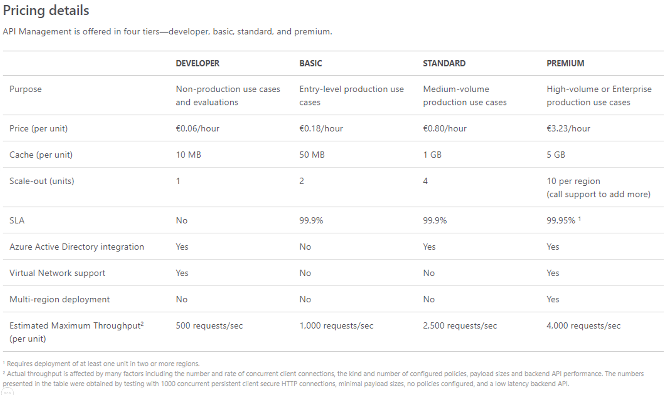

Slide 10
NEW API Management tier – “Consumption”
API management layer for microservice-based architectures
Serverless properties
Instant provisioning
Automated scaling - out and back to zero
Built-in high availability
Per action pricing
Curated feature set, e.g.
No developer portal
Bring your own response cache
Usage limits
Available in public preview on December 2018

Slide 11
Stay in touch
Tutorials, documentation, and references | http://aka.ms/apimdocs
Questions and discussions | http://aka.ms/apimso
Policy samples | http://aka.ms/apimpolicyexamples
Automation guidance | http://aka.ms/apimdevops
Service updates | http://aka.ms/apimupdates
Roadmap | http://aka.ms/apimroadmap
Feedback and feature requests | http://aka.ms/apimwish
Customer stories | http://aka.ms/apimcustomers

Slide 12
Q&A WPC026
Domande e risposte

Slide 13
WPC026 - Azure API Management step by step
RICCARDO CAPPELLO
@rcappello
rcappello@outlook.com
Operative manager @alten italia Microsoft Azure MVP Intel Software Innovator

Slide 14

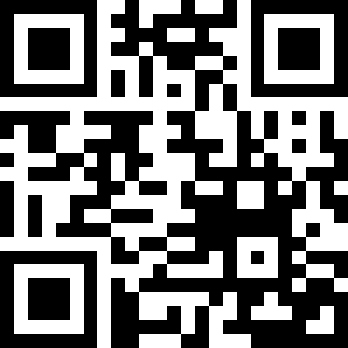

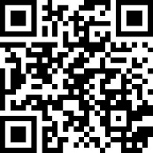

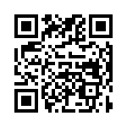
Contatti
OverNet Education
Info@OverNetEducation.it
www.OverNetEducation.it
Rozzano (MI) +39 02 365738
Bologna +39 051 269911
www.wpc-overneteducation.it
ROZZANO (MI) BOLOGNA ROMA GENOVA TORINO NAPOLI

